Slide 1
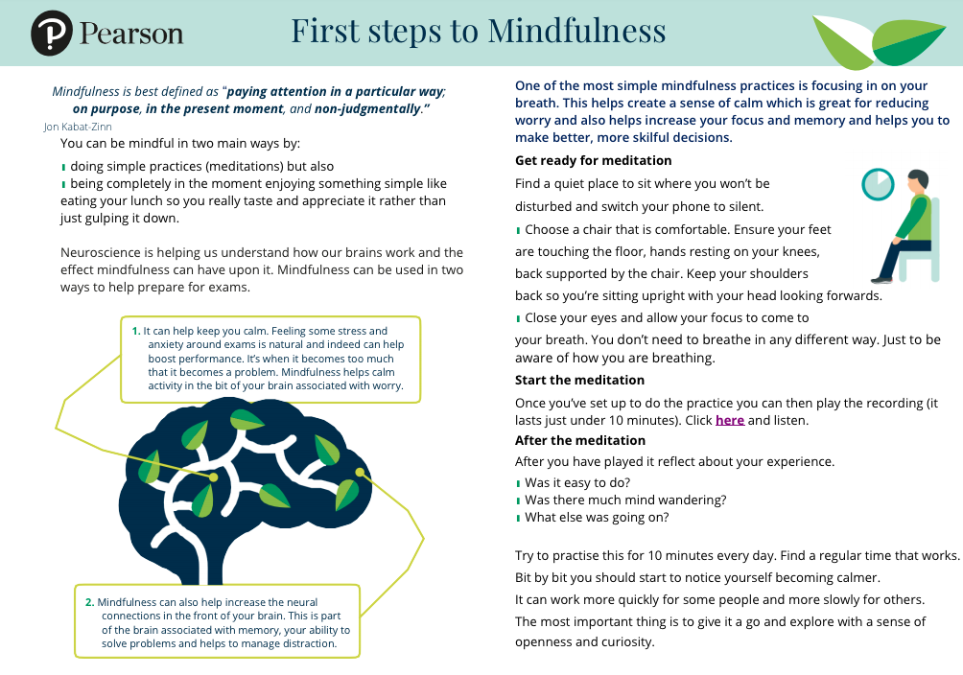
Take a moment for mindfulness each day

Slide 2
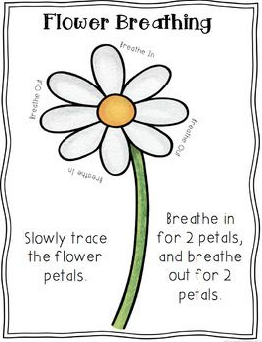
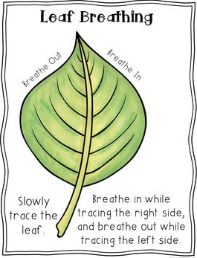
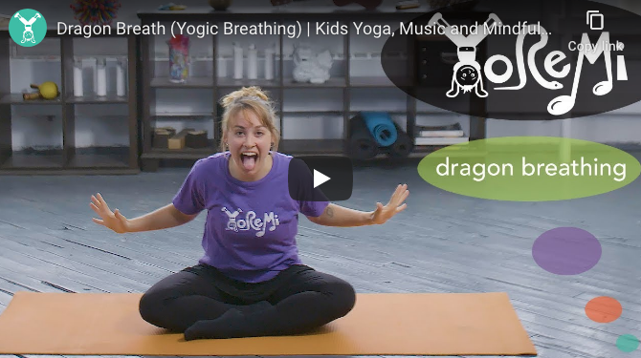
Breathing Exercises

Slide 3
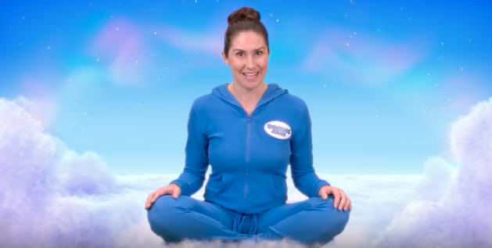
Breathing Exercises
Listening Game - Cosmic Kids
Click the picture to enter the Zen Den!

Slide 4
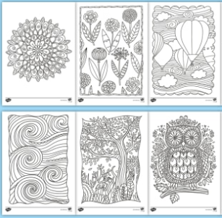
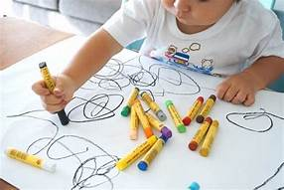
Colouring and Doodling
Click the Twinkl pictures for the link, they are offering free membership for a month at the moment.
If you haven’t got a printer, doodling is just as good and even more creative.

Slide 5
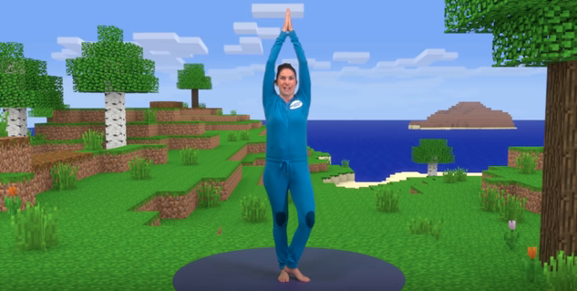
Yoga - Cosmic Kids
Click above for the Minecraft One!
Lots more available on youtube and youtube kids.

Slide 6
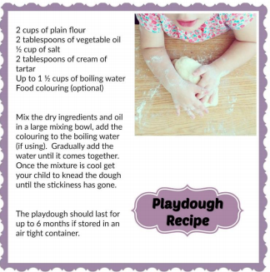
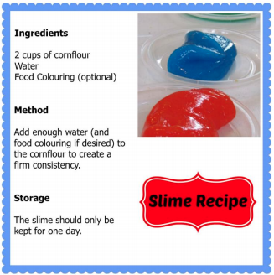
Sensory input and grounding
Using your five senses and exploring these allows you to become more aware of the moment. An essential part of mindfulness. Find textures, smells, tastes, sights and sounds that you really enjoy.

Slide 7
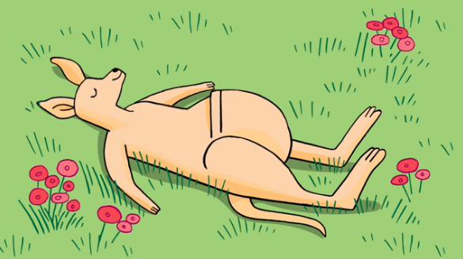
The Body Scan
In this video, you’ll use your imagination to boost your superpowers of focus and calm by relaxing each part of your body with the help of a magical butterfly.

Slide 8
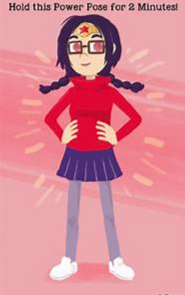
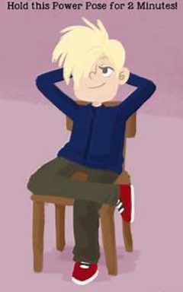
Building Confidence - The Power Pose
Hold one of these poses for two minutes whenever you need a confidence boost!

Slide 9
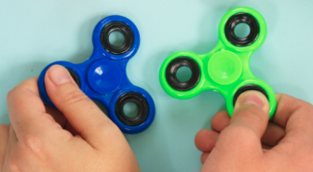
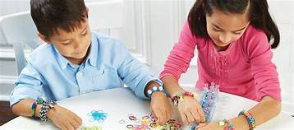
Loom Bands, Crafts and Fiddle Toys
Taking part in art and craft activities can help your child in many ways. Arts and crafts activities can help to develop your child’s imagination and creativity, their planning and organisation skills and fine motor skills. Fiddly and repetitive activities have a calming effect and are immensly satisfying!

Slide 10
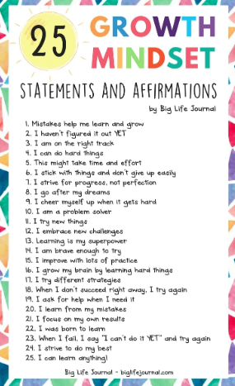
Affirmations
Part of building a positive mindset is all about belief. By training yourself to use positive words and phrases about yourself you will build belief in yourself.
Yes you can!
Repeat it and believe it!
Every day!

Slide 11
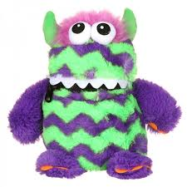
Worry Monster
As you know my friends and I have moved into The Prince of Wales School. We are very hungry monsters! So if you are learning at home, please write any worries down and keep them in a jar or box. You can feed them to us when you return. Don’t forget to share your worries with your family too.

Slide 12
Keep Active!
Keeping active every day is really important to keep your energy levels in check and to shake off your stress! Click the picture link to go to the BBC’s Super movers page. Try and be active every day when you are at home.

Slide 13
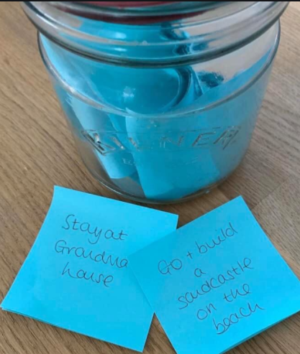
Hopes and Dreams Jar
At the moment we have to stay at home to keep us and our family safe and well. But that won’t be forever. There must be trips and visits away from home that you are missing, so each day write them down on a piece of paper and put them into a jar. When we find our rainbow and can start going out again with our family and friends, you will have a whole Jar of things to do!

Slide 14
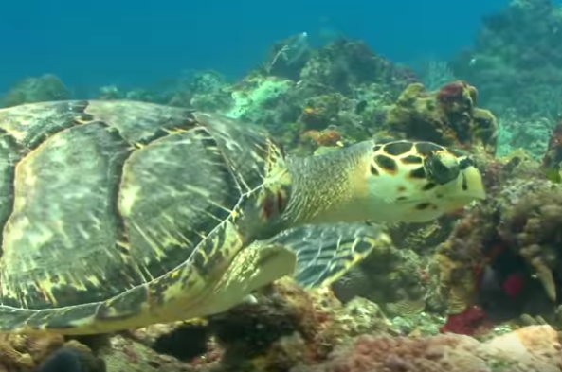
Relaxing Coral Reef
Take time out to watch these relaxing scenes from the coral reef. Amazing 4K footage of underwater life! Click on the picture to visit the ocean!

Slide 15
Looking at the sky
When was the last time you spent a while looking at the clouds? Staring at the sky can be a good quality mindful moment. Choose a comfortable place in your garden and see what you can see in the clouds. If you wrap up warm, you could even try it at night! Just be sure to not look directly at the Sun!

Slide 16
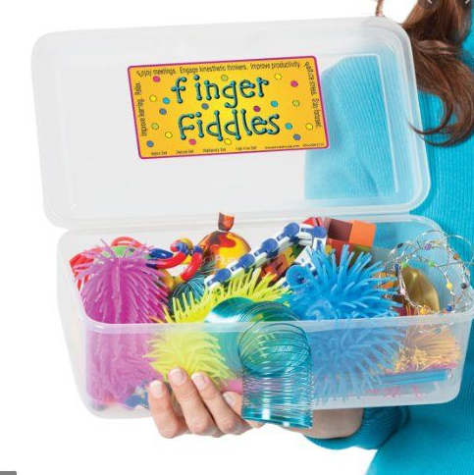
Fiddle Fantastic
Create your own Fiddle Box, containing all of the things that you like to touch. Touch can be such an underrated sense! It could be a favourite fiddle toy that you have or just a piece of fabric that you like the feel of. Get stuck in when you are feeling a bit tense or anxious, or if you just want to relax.

Slide 17
Jamie’s Brain Breaks
Cosmic Kids Series of Brain Breaks gives simple and fun mini yoga sessions that can be completed in about 5 minutes. Why not have a go to break up the day? They might be useful for between home school activities, or when the activities aren’t going too well!

Slide 18
Guided Relaxation / Creative Visualisation
Guided Relaxation and Creative Visualisation guides you and your children through a relaxing story. Allowing you to imagine the story that is being told as you relax and enjoy. This one is all about a treehouse.

Slide 19
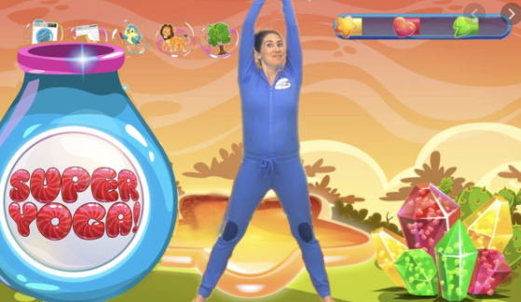
Stretch
Taking time to stretch out those tired muscles is always satisfying. You can do this yourself following slow long stretches that we usually do in PE. If you would like some guidance click on the Super Yoga link on the left. Remember: Don’t push yourself too far and do it slowly!

Slide 20
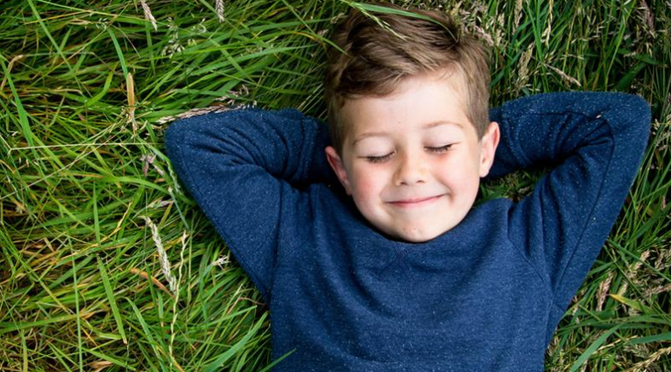
Mindful Moment’s from CBeebies
Seven wonderful mindful moments from CBeebies. Mindful Munching, Laughing Together, Breathing Deep, Stretching, Cloud Spotting, CBeebies Radio and Doodling! Click the picture for the link!

Slide 21
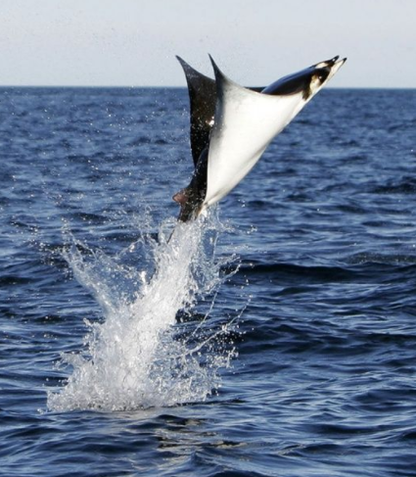
Awe and Wonder
Sometimes you see something that makes you go “Wow!”.
It gives you that warm feeling inside and the knowledge that the world is such an incredible place with things to see that have never been seen before.
I love these Manta Rays leaping out of the ocean. Click on the picture to see the video!

Slide 22
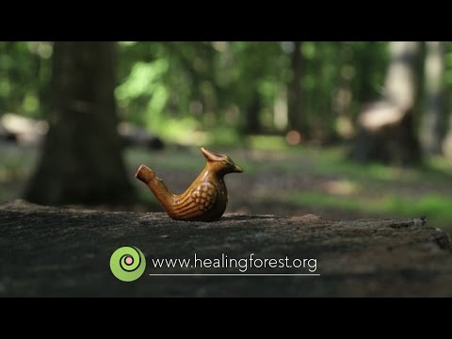
#InspiredToLearn - Half Term Mindful Moment
Forest Bathing
A trip to the woods is a bit of a treat at the moment, so if you can’t get to go to the real thing have a go at Forest Bathing courtesy of RSPB Arne in this video:
Forest Bathing Arne
Your teacher would love to see your finished work. Feel free to class dojo a picture

Slide 23
#InspiredToLearn - Half Term Mindful Moment
Peace Out!
Time to relax and have a mindful moment with Jamie from Cosmic Kids. She has made this special film to help you to relax and let go of some of those anxieties and worries.
Your teacher would love to see your finished work. Feel free to class dojo a picture

Slide 24
#InspiredToLearn - Half Term Mindful Moment
Yoga
Star Wars Special Yoga Anyone?
Join Jamie and Cosmic Kids for this Yoga session.
Your teacher would love to see your finished work. Feel free to class dojo a picture

Slide 25
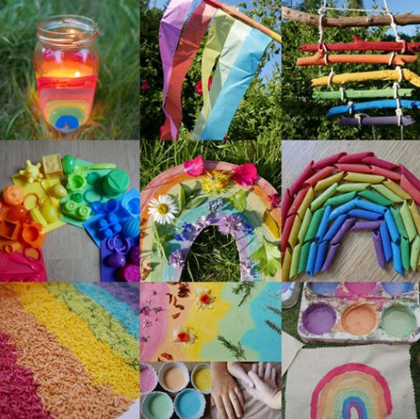
#InspiredToLearn - Half Term Mindful Moment
Sensory Rainbows
The symbol of the Rainbow has been a powerful reminder of hope in recent weeks. How about creating a sensory rainbow that has all kinds of touchy feely elements!
Your teacher would love to see your finished work. Feel free to class dojo a picture

