Slide 1
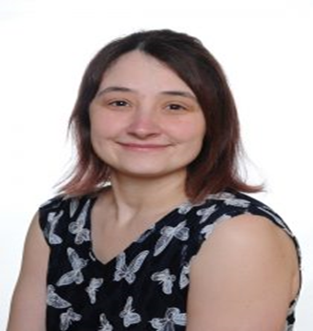
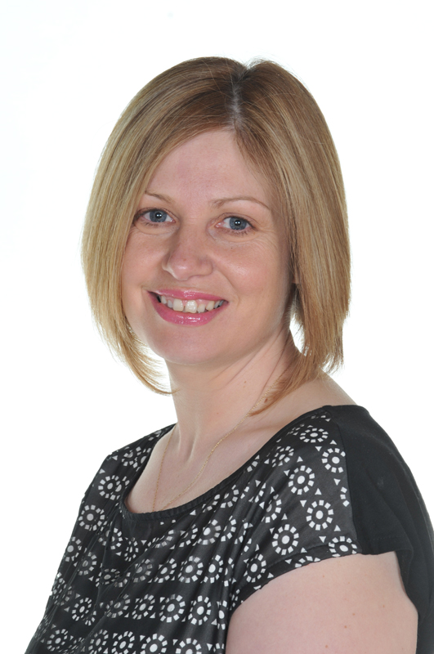
Meet The Hive Team.
My Name is Mrs Adams and I work with Mrs Alcock in The Hive. I will also be one of the teaching assistants in years 5/6 from September 2021.
I have worked at St Giles & St George’s for nearly 17 years and have worked with many children from across school.
Outside of school I enjoy spending time with my three children. I also like to cook, read, listen to music and spend time in my garden.
My Name is Mrs Alcock and I work with Mrs Adams in The Hive. I am a trained ELSA (Emotional Literacy Support Worker) and I am also the schools attendance officer.
I have worked at St. Giles’ & St. George’s for 12 years and enjoy being out and about around the school with the children.
I have 2 children who I love spending time with, I also like Walking, running, Cycling but to relax I like to sit and read.

